Slide 1
INDIAN PHYSIOGRAPHY: PLATEAUS
SANDEEP JHA
ASSISTANT PROFESSOR
DEPARTMENT OF GEOGRAPHY
B.M.COLLEGE, RAHIKA MADHUBANI

Slide 2
INTRODUCTION
The peninsular Plateau lies towards the south of the Indo- Gangetic Plain.
Peninsular plateau is a triangular shaped table land.
The shape of the plain is triangle its broad base to the north and the narrow apex to the south.
It is part of ancient land mass called Gondwana level.
It covers an area of nearly 5 lakh sq.km.
It is spread over the states of Gujarat, Maharashtra, Bihar, Karnataka and Andhra Pradesh.
Aravalli hill mark the North-Western boundary, Northern edge of the Bundelkhand Plateau Eastern & Western Ghats at East and West and south Part is connect with the Indian Ocean.

Slide 3
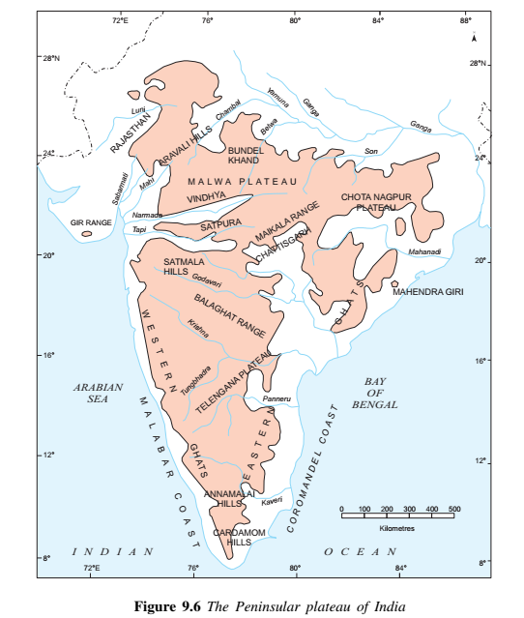

Slide 4
Peninsular Plateau is Divided into the Two Types
North Indian Peninsular Plateau.
✓ It is Classified into Three region
i. The western Highland region
ii. The Central Highland region
iii. The Eastern High land region.
Southern Indian Peninsular Plateau.
i. The Deccan Plateau.
ii. The Western Ghat.
iii. The Eastern Ghat.
River Narmada divides the peninsular plateau into two parts:
I) The Central Highland and II) Deccan Plateau

Slide 5
The central Highlands
It extends from Narmada river and the northern plains.
Aravalli is the important mountain which extends from Gujrat through Rajasthan to Delhi. The highest peak of the Aravalli hills is Gurushikhar (1722m) near Mt.Abu.
The Aravali Range is the oldest mountain range in India. It is spread across Rajasthan from northeast to southwest direction extending approximately to 800 km.
The Malwa Plateau and Chhota Nagpur plateau are parts of the central highlands.

Slide 6
Malwa Plateau
The Malwa Plateau is spread across Rajasthan, Madhya Pradesh and Gujarat.
The average elevation of the Malwa plateau is 500 metres.
Most of the region is drained by the Chambal River and its tributaries; the western part is drained by the
upper reaches of the Mahi River.
The valley of Narmada is lies between the Vindhyas and the Satpura which flows east to west and joins the Arabian sea.

Slide 7
Chota Nagpur Plateau
The Chota Nagpur Plateau is situated in eastern India, covering much of Jharkhand and adjacent parts of Orissa, Bihar and Chhattisgarh. Its total area is approximately 65,000 sq. km and is made up of three smaller plateaus
a) the Ranchi,
b) Hazaribagh, and
c) Kodarma plateaus.
The Ranchi plateau is the largest, with an average elevation of 700 m .

Slide 8
The Deccan Plateau
The Deccan plateau is separated by a fault from Chota Nagpur plateau.
The black soil area in the Deccan plateau is known as Deccan trap.
It is formed due to volcanic eruptions.
This soil is good for cotton & sugarcane cultivation.
The Deccan plateau is broadly divided into:
A) Western Ghat
B) Eastern Ghat

Slide 9
The Western Ghats
Western Ghats or Sahyadris lie on theWestern edge of the Deccan plateau.
It runs parallel to the western coast for about 1600 km.
The average elevation of the Western Ghats is 1000 metres.
The famous peaks in this area are Doda Betta, Anaimudi and Makurti.
The highest peak in this region is Anaimudi (2695m.).
Western ghats are continuous and can be crossed through passes like Pal Ghat, Thal Ghot and Bhor Ghat.
The rivers like Godavari, Bhima and Krishna flow eastward while the river Tapti flows
westward.
The streams form rapids & water falls before entering the Arabian Sea.
The famous water falls are Jogfalls on Sharavati, Shiva Samudram falls on Kaveri etc.

Slide 10
The Eastern Ghats
The Eastern Ghats are discontinuous low belt.
Their average elevation is 600 m.
They run parallel to the east coast from south of Mahanadi valley to the Nilgiri hills.
The highest peak in this region is Mahendragiri (1501 m).
The famous hills are Mahendragiri hills, Nimaigiri hills in Orissa, Nallamallai hills in Southern Andhra Pradesh, Kollimalai and Pachaimalai in Tamilnadu.
The area is drained by the Mahanadi, Godawari, Krishna and Kaveri river system.
The Nilgiri hills join Western & Eastern Ghats in the south.

Slide 11
The Coastal Plains
The coastal plains in India run parallel to the Arabian Sea & Bay of Bengal along the Peninsular Plateau.
The western coastal plain is a narrow belt along the Arabian sea of about 10-20 km wide.
It stretches from Rann of Kachchh to KanyaKumari. Western coastal plains comprises of three sectors
(i) Konkan Coast (Mumbai to Goa),
(ii) Karnataka coast from Goa to Mangalore
(iii) Malabar Coast (Mangalore to Kanya Kumari).
The eastern coast runs along Bay of Bengal. It is wider than the western coastal plain.
Its average width is about 120Kms. The northern part of the coast is called Northern Circar and the southern part is called Coromandal Coast.
Eastern coastal plain is marked by Deltas made by the rivers Mahanadi, Godavari, Krishna amd Kaveri.
The Chilka largest salt water lake in India in Odisha is located to the south of Mahanadi Delta.
The coastal plains are belts for growing spices, rice, coconut, pepper etc.
They are centres of trade & commerce.
The coastal areas are known for fishing activities, therefore large number of fishing villages have developed along the coasts. Vembanad is famous lagoon which is located at Malabar coast

Slide 12
THANK YOU

